Slide 1
Snake
Game
PPT By Kunal Bhatt

Slide 2
Table of Contents
Project Description
Explanation of code
Code
Output

Slide 3
Project Description
In Our childhood we all play games like Mario, Contra, Street Runner, etc and those game makes memories in our childhood so refresh our those memories I made this game called Snake game.
It’s a basic game in which there is a snake which eat food and get bigger I replicate it through C++ Language and make this project.

Slide 4
Working of the Project
The snake is represented with a “0” symbol.
The fruit is represented with an “F” symbol.
The snake can move in any direction according to the user with the help of the keyboard (W, A, S, D keys).
When the snake eats a fruit the score will increase by 10 points.
The fruit will generate automatically within the boundaries.
Whenever the snake will touch the boundary the game is over.

Slide 5
Explanation Of Code
The user-defined functions created in this program are given below:
Draw(): This function creates the boundary in which the game will be played.
Setup(): This function will set the position of the fruit within the boundary.
Input(): This function will take the input from the keyboard.
Logic(): This function will set the movement of the snake.

Slide 6
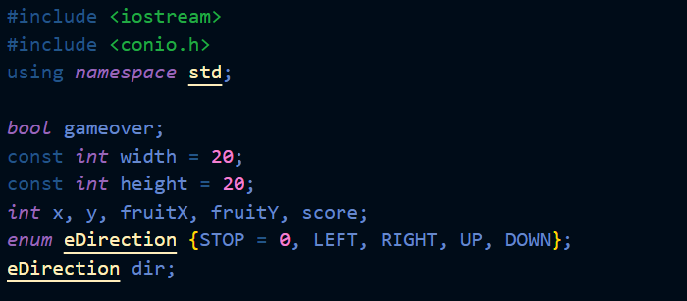
Built-in functions used:
kbhit(): This function in C ++ is used to determine if a key has been pressed or not. To use this function in a program include the header file conio.h. If a key has been pressed, then it returns a non-zero value otherwise it returns zero.
rand(): It returns a random integer value every time it is called.
Header files and variables:
The header files and variables used in this program are:

Slide 7
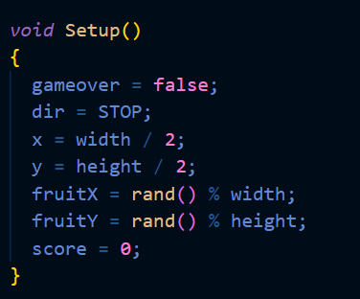
Draw(): This function is responsible to build the boundary within which the game will be played.
setup():This function is used to write the code to generate the fruit within the boundary using rand() function. Using rand()% width because the size of the boundary is length = 20 and width = 20 so the fruit will generate within the boundary.

Slide 8
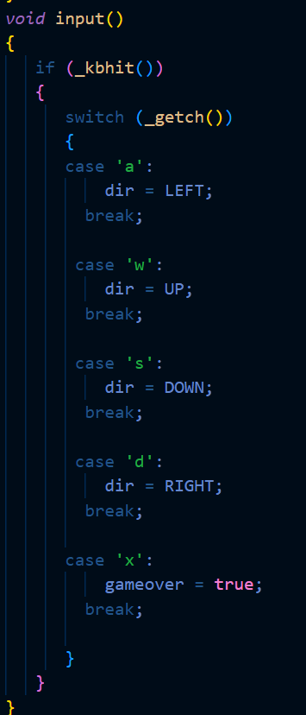
Input(): In this function, the programmer writes the code to take the input from the keyboard (W, A, S, D, X keys).

Slide 9
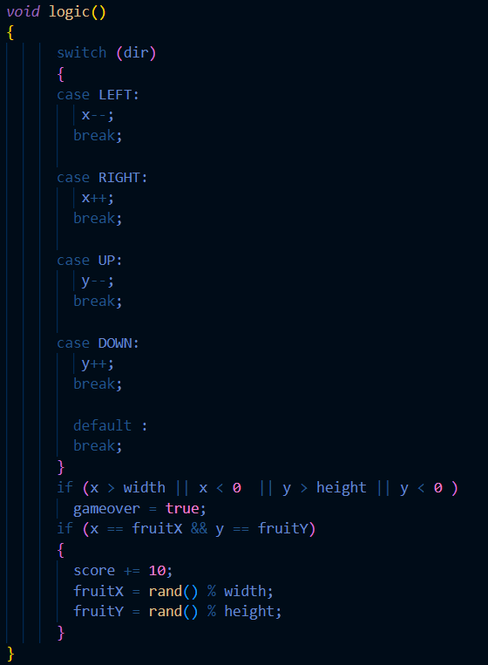
logic(): Here, write all the logic for this program like for the movement of the snake, for increasing the score, when the snake will touch the boundary the game will be over, to exit the game and the random generation of the fruit once the snake will eat the fruit.

Slide 10
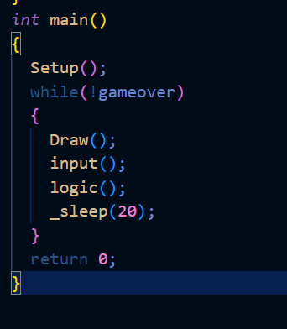
sleep(): This function delays the program execution for the given number of seconds. In this code sleep() is used to slow down the movement of the snake so it will be easy for the user to play.
main(): From the main() function the execution of the program starts. It calls all the functions.

